Slide 1
OPERATOR OVERLOADING PART 2
Assignment Operator

Slide 2
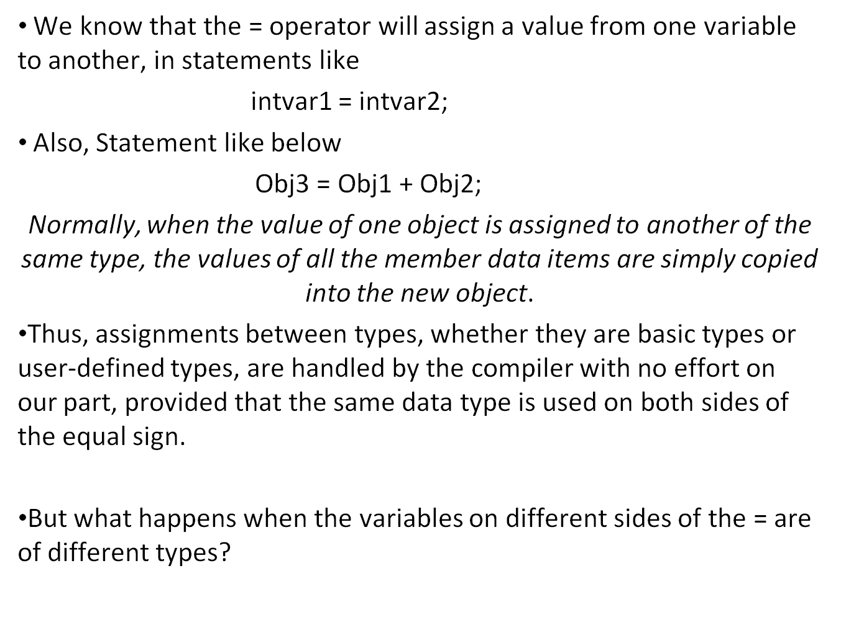
OPERATOR OVERLOADING
Assignment Operator ‘=’

Slide 3
ASSIGNMENT OPERATOR =
Conversion Between Basic Type
Statement like this
intVar = floatVar;
where intvar is of type int and floatvar is of type float,
Here the compiler will call a special routine to convert the value of floatvar, which is expressed in floating-point format, to an integer format so that it can be assigned to intvar.
There are also other conversions: from float to double, char to float, and so on. Such conversions are implicit.
Sometimes we want to force the compiler to convert one type to another. To do this we use the cast operator.
Example1 floatVar= float(intVar;)
Example 2 intvar = static_cast<int>(floatvar);
When we want to convert between user-defined data types and basic types, we can’t rely on built-in conversion routines, since the compiler doesn’t know anything about user-defined types.

Slide 4
ASSIGNMENT OPERATOR =
Conversion between Objects and Basic Types (Example)
class Distance {
private:
int feet;
float inches;
public:
Distance() : feet(0), inches(0.0)
{ }
Distance(float meters) {
float fltfeet = 3.28 * meters;
feet = int(fltfeet);
inches = 12*(fltfeet-feet);
}
Distance(int ft, float in) : feet(ft),inches(in)
{ }
void showdist() const
{ cout << feet << “\’-” << inches << ‘\”’; }
operator float() const //conversion operator
{
float fracfeet = inches/12;
fracfeet += static_cast<float>(feet);
return fracfeet/3.28;
}
};

Slide 5
ASSIGNMENT OPERATOR =
Conversion between Objects and Basic Types (Example)
void main()
{
float mtrs;
Distance dist1 = 2.35F;
cout << “\ndist1 = “; dist1.showdist();
mtrs = static_cast<float>(dist1); //uses conversion operator for Distance to meters
cout << “\ndist1 = “ << mtrs << “ meters\n”;
Distance dist2(5, 10.25);
mtrs = dist2; //also uses conversion op
cout << “\ndist2 = “ << mtrs << “ meters\n”;
}

Slide 6
ASSIGNMENT OPERATOR =
Conversion Between objects of Different Classes
Converting between objects of different user-defined classes uses the same two methods
  you can use a one-argument constructor (conversion constructor)
  you can use a conversion operator.
The choice depends on whether you want to put the conversion
routine in the class declaration of the source object or of the destination object. e.g.
objecta = objectb;
where objecta is a member of class A and objectb is a member of class B.
Is the conversion routine located in class A (the destination class, since objecta receives the value) or class B (the source class)

Slide 7
CONVERSION BETWEEN OBJECTS OF DIFFERENT CLASSES
Routine in Destination Object(Require conversion constructor)
class time24 {
private:
int hours;
int minutes;
int seconds;
public:
time24() : hours(0), minutes(0), seconds(0)
{ }
time24(int h, int m, int s):
hours(h), minutes(m), seconds(s)
{ }
int getHrs() const { return hours; }
int getMins() const { return minutes; }
int getSecs() const { return seconds; }
};

Slide 8
CONVERSION BETWEEN OBJECTS OF DIFFERENT CLASSES
Routine in Destination Object(Require conversion constructor)
class time12{
private:
bool pm;
int hrs;
int mins;
public:
time12() : pm(true), hrs(0), mins(0)
{ }
time12(time24 t24) {
      int hrs24 = t24.getHrs();
      pm = t24.getHrs() < 12 ? false : true;
      mins = t24.getMins;
      hrs = (hrs24 < 13) ? hrs24 : hrs24-12;
}
time12(bool ap, int h, int m) : pm(ap), hrs(h), mins(m)
{ }
};

Slide 9
CONVERSION BETWEEN OBJECTS OF DIFFERENT CLASSES
Routine in Destination Object(Require conversion constructor)
void main()
{
time24 t24(16, 30, 20); //make a time24
time12 t12 = t24; //convert time24 to time12
}

Slide 10
CONVERSION BETWEEN OBJECTS OF DIFFERENT CLASSES
Routine in Source Object(Require conversion operator)
Do it your self, using the same previous example
write conversion operator routine/function in the source class

